Slide 1
Part I: What is BDS & How Does It Work?
bdsmovement.net
uscpr.org/bdstoolkit

Slide 3
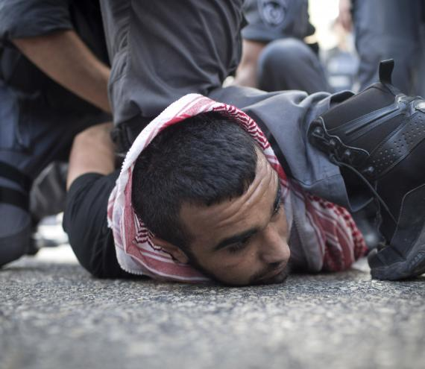
1. End the Occupation & Dismantle the Walls
Credit: ActiveStills

Slide 4
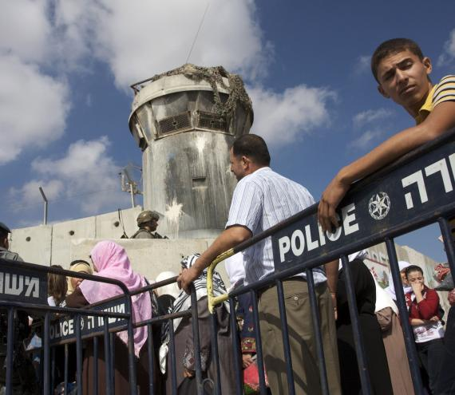
2. Equality for Palestinian Citizens of Israel
Credit: ActiveStills

Slide 5
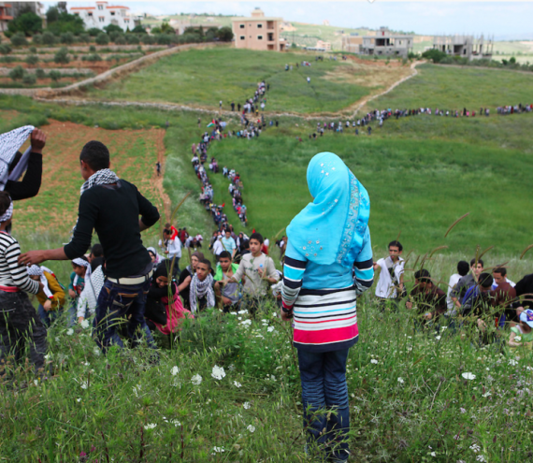
3. Right of Return for Palestinian Refugees
Credit: Matthew Cassel

Slide 8
BDS as a Strategy for Change
End the Occupation
Equality for Palestinian citizens of Israel; end to racist laws
WHY
Freedom
Justice
Right of return for refugees
Equality
WHAT
HOW
Boycotts
Divestments
Sanctions

Slide 9
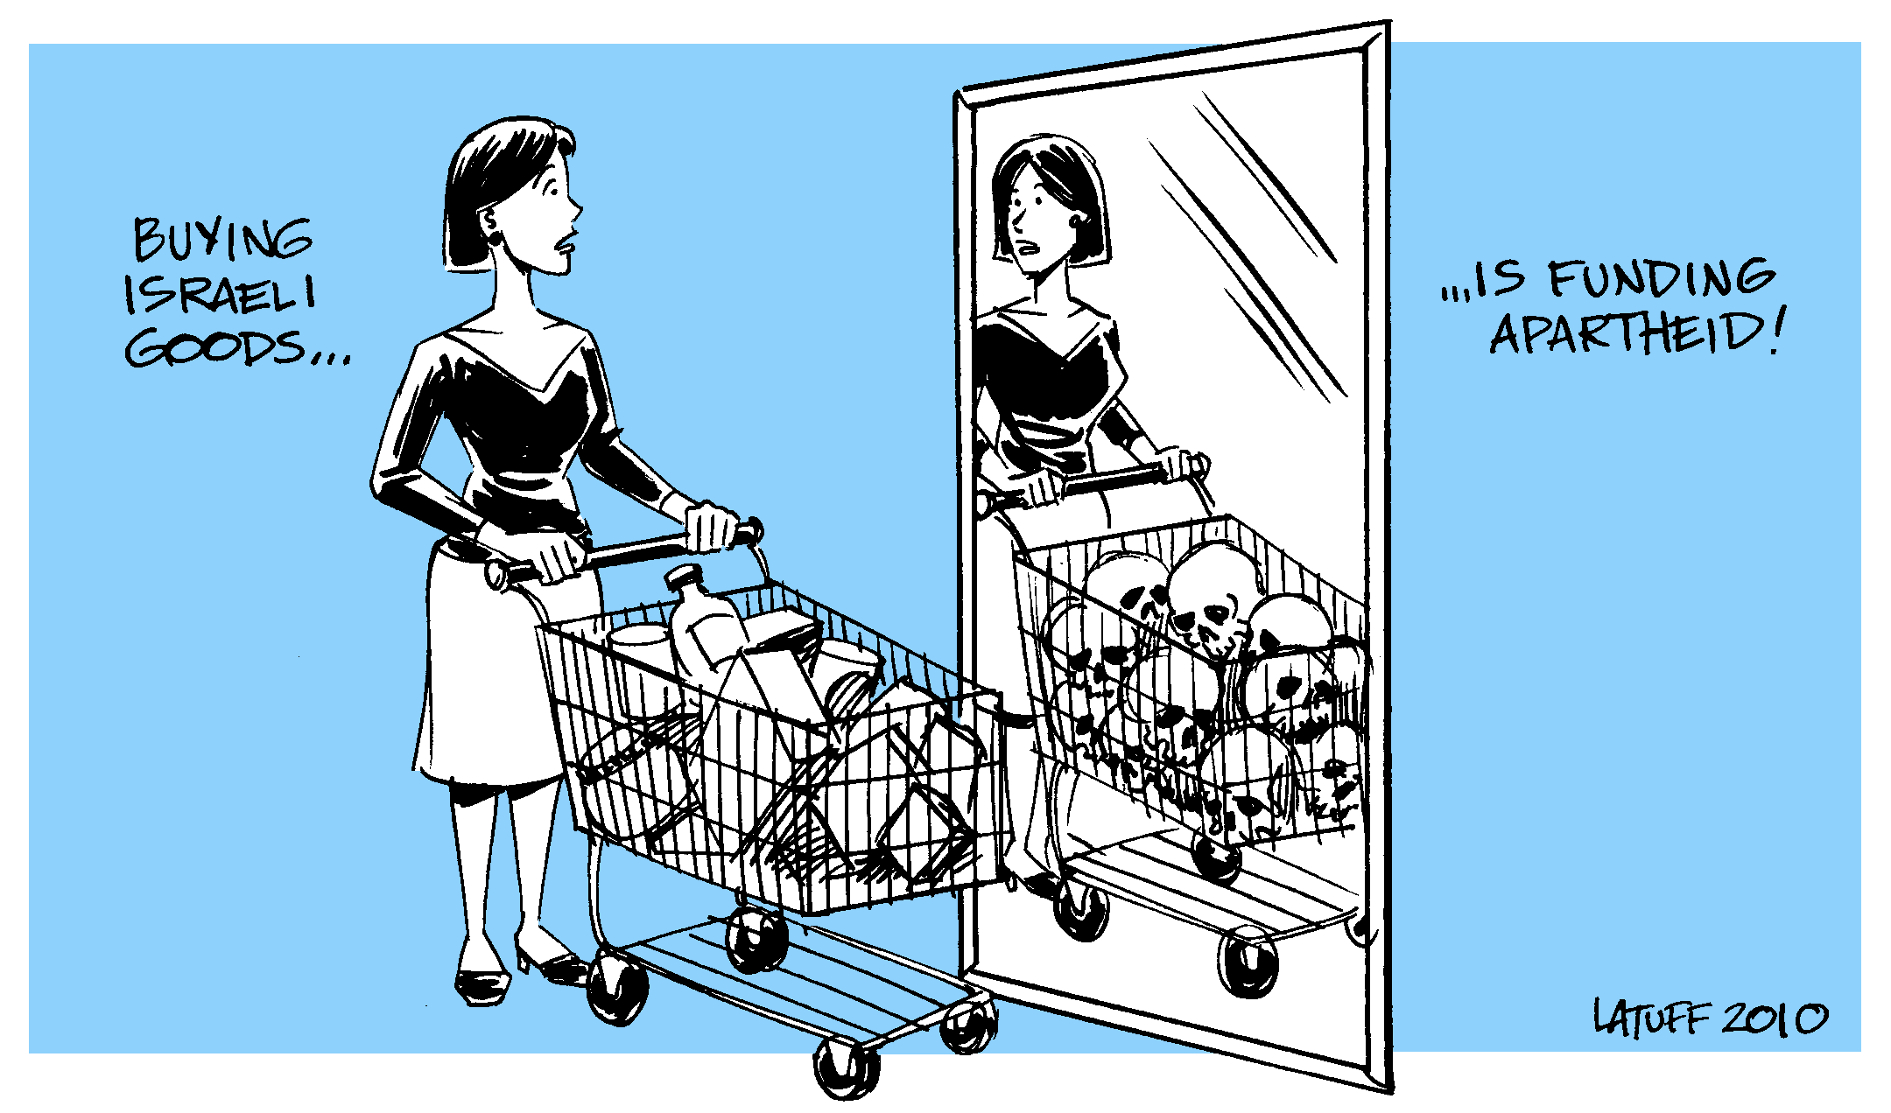

Slide 11
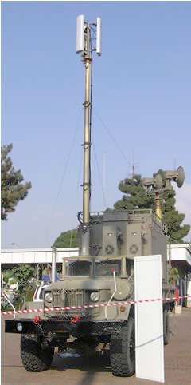

Slide 12
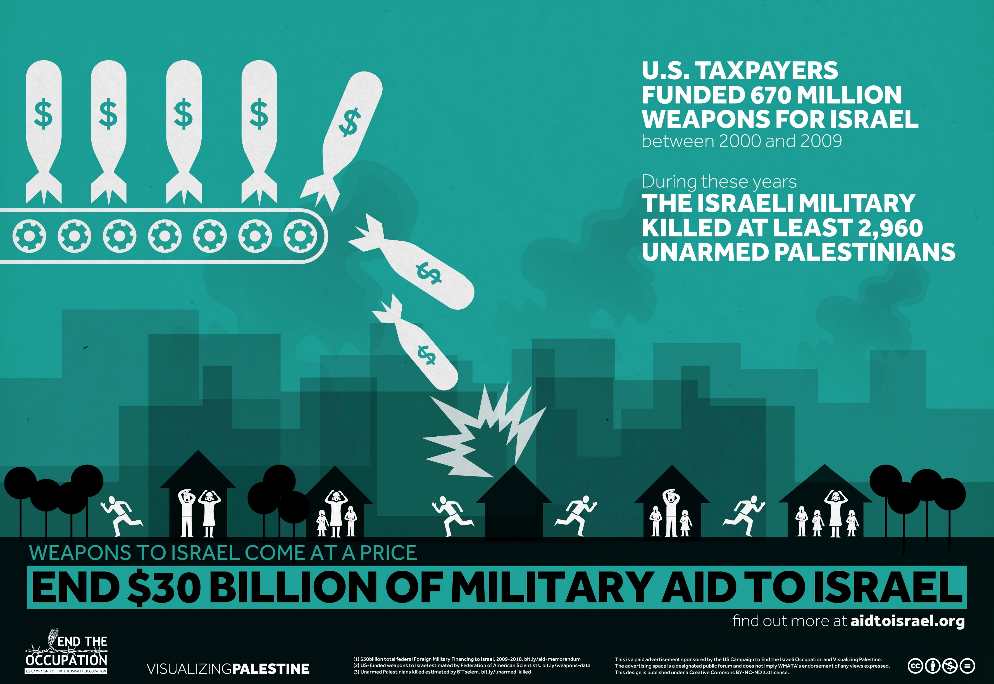

Slide 15
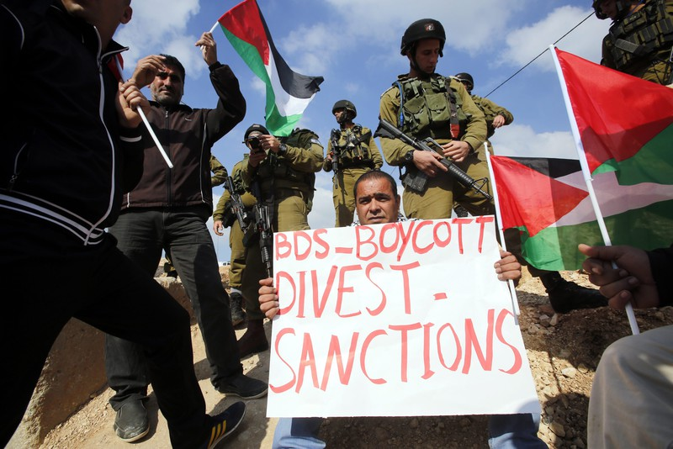
Why BDS?
Shifting Power
Educational Impact
Accountability
It Works!

Slide 16
It Works!
46% drop in foreign direct investment in Israel in 2014
Could reduce Israel’s GDP by 1-2% annually
Exports to the Palestinian economy down 24% in 2015
“Less desire for Israeli-made products”
Primary “strategic threat” to Israel

Slide 17
Credit: Suhad Khatib

Slide 18
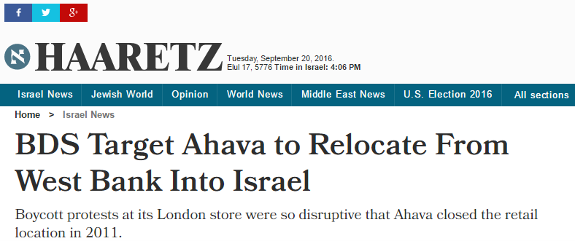

Slide 19
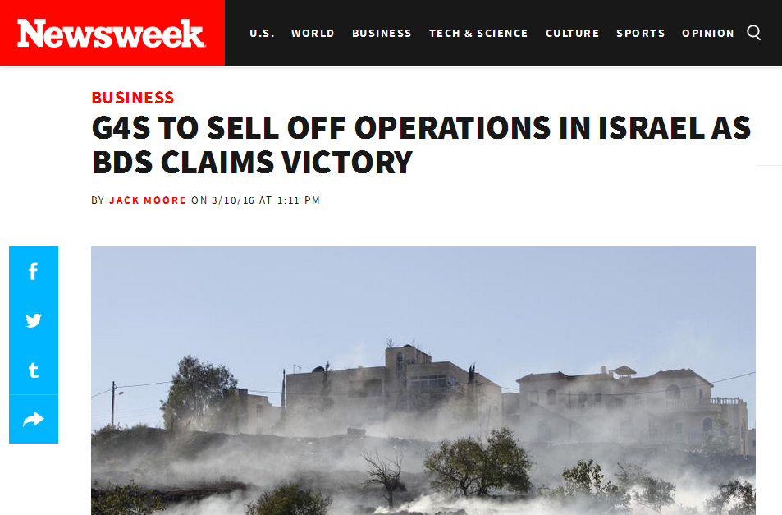

Slide 21
uscpr.org/bdswins

Slide 22
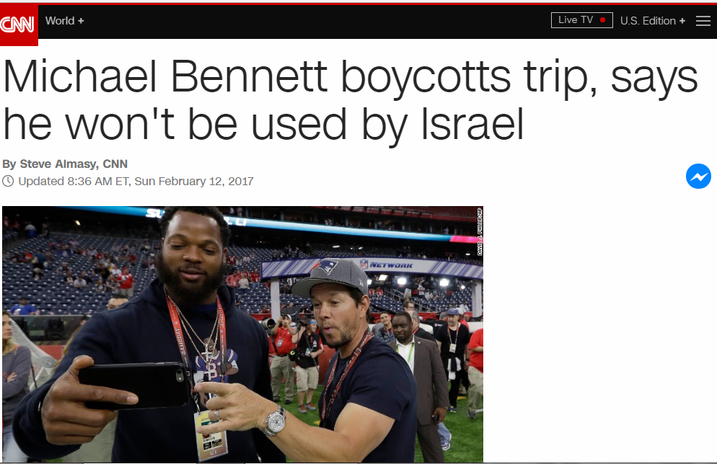
NFL players cancel trip to Israel

Slide 23
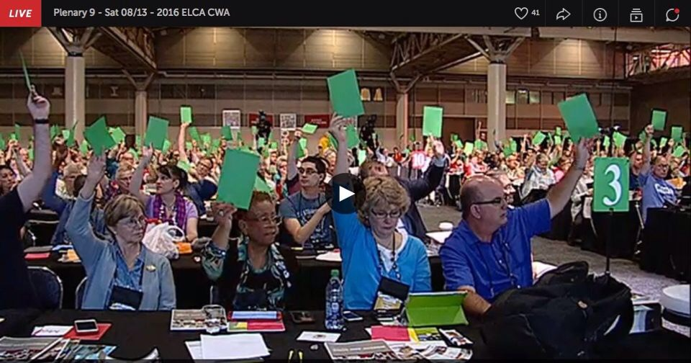
Churches vote to end investments in occupation

Slide 24
Divestment Resolutions Passed on 35+ Campuses

Slide 25
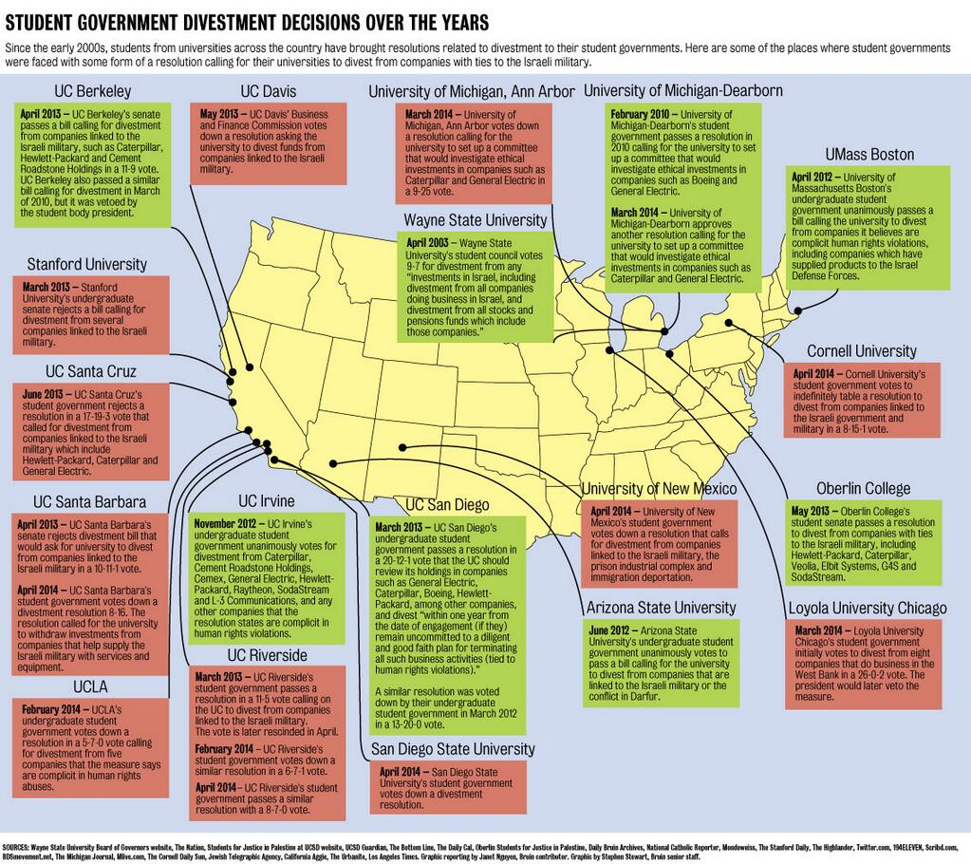
Divestment Resolutions Passed on 35+ Campuses

Slide 26
8+ Academic Associations endorsed BDS or academic boycott

Slide 27
Unions Endorse BDS

Slide 28
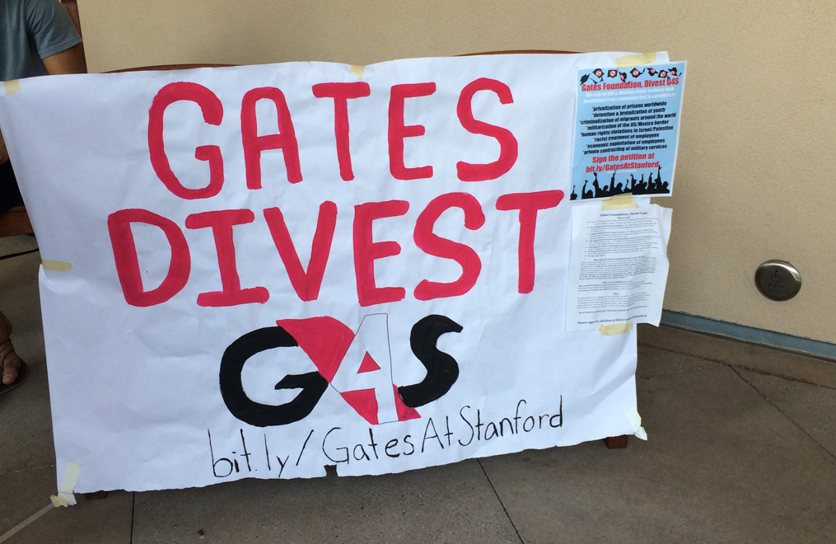
Major Investment Funds Divested

Slide 29
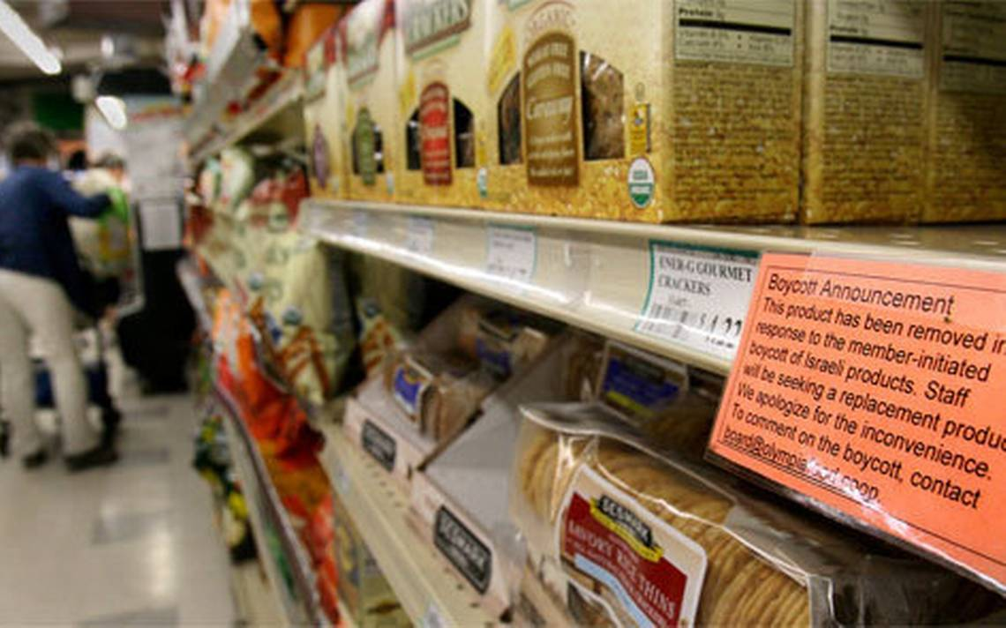
Israeli Products De-shelved

Slide 30
Activists Block Unloading of Israeli Ships

Slide 31
Successful Municipal Boycott & Divestment Campaigns
Credit: Suhad Khatib

Slide 33
Part II: How to Prepare a BDS Campaign
bdsmovement.net
uscpr.org/bdstoolkit

Slide 34
Part II: How to Prepare a BDS Campaign
Part III: How to Win your BDS Campaign
bdsmovement.net
uscpr.org/bdstoolkit

