Slide 1
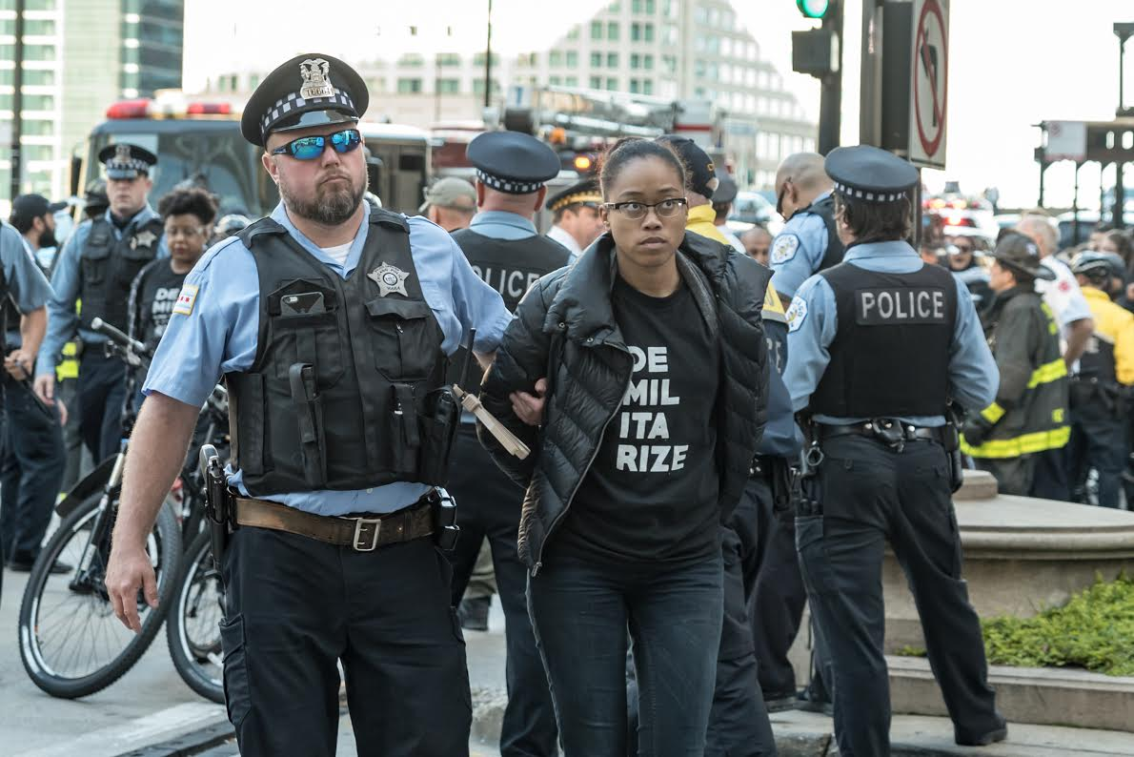
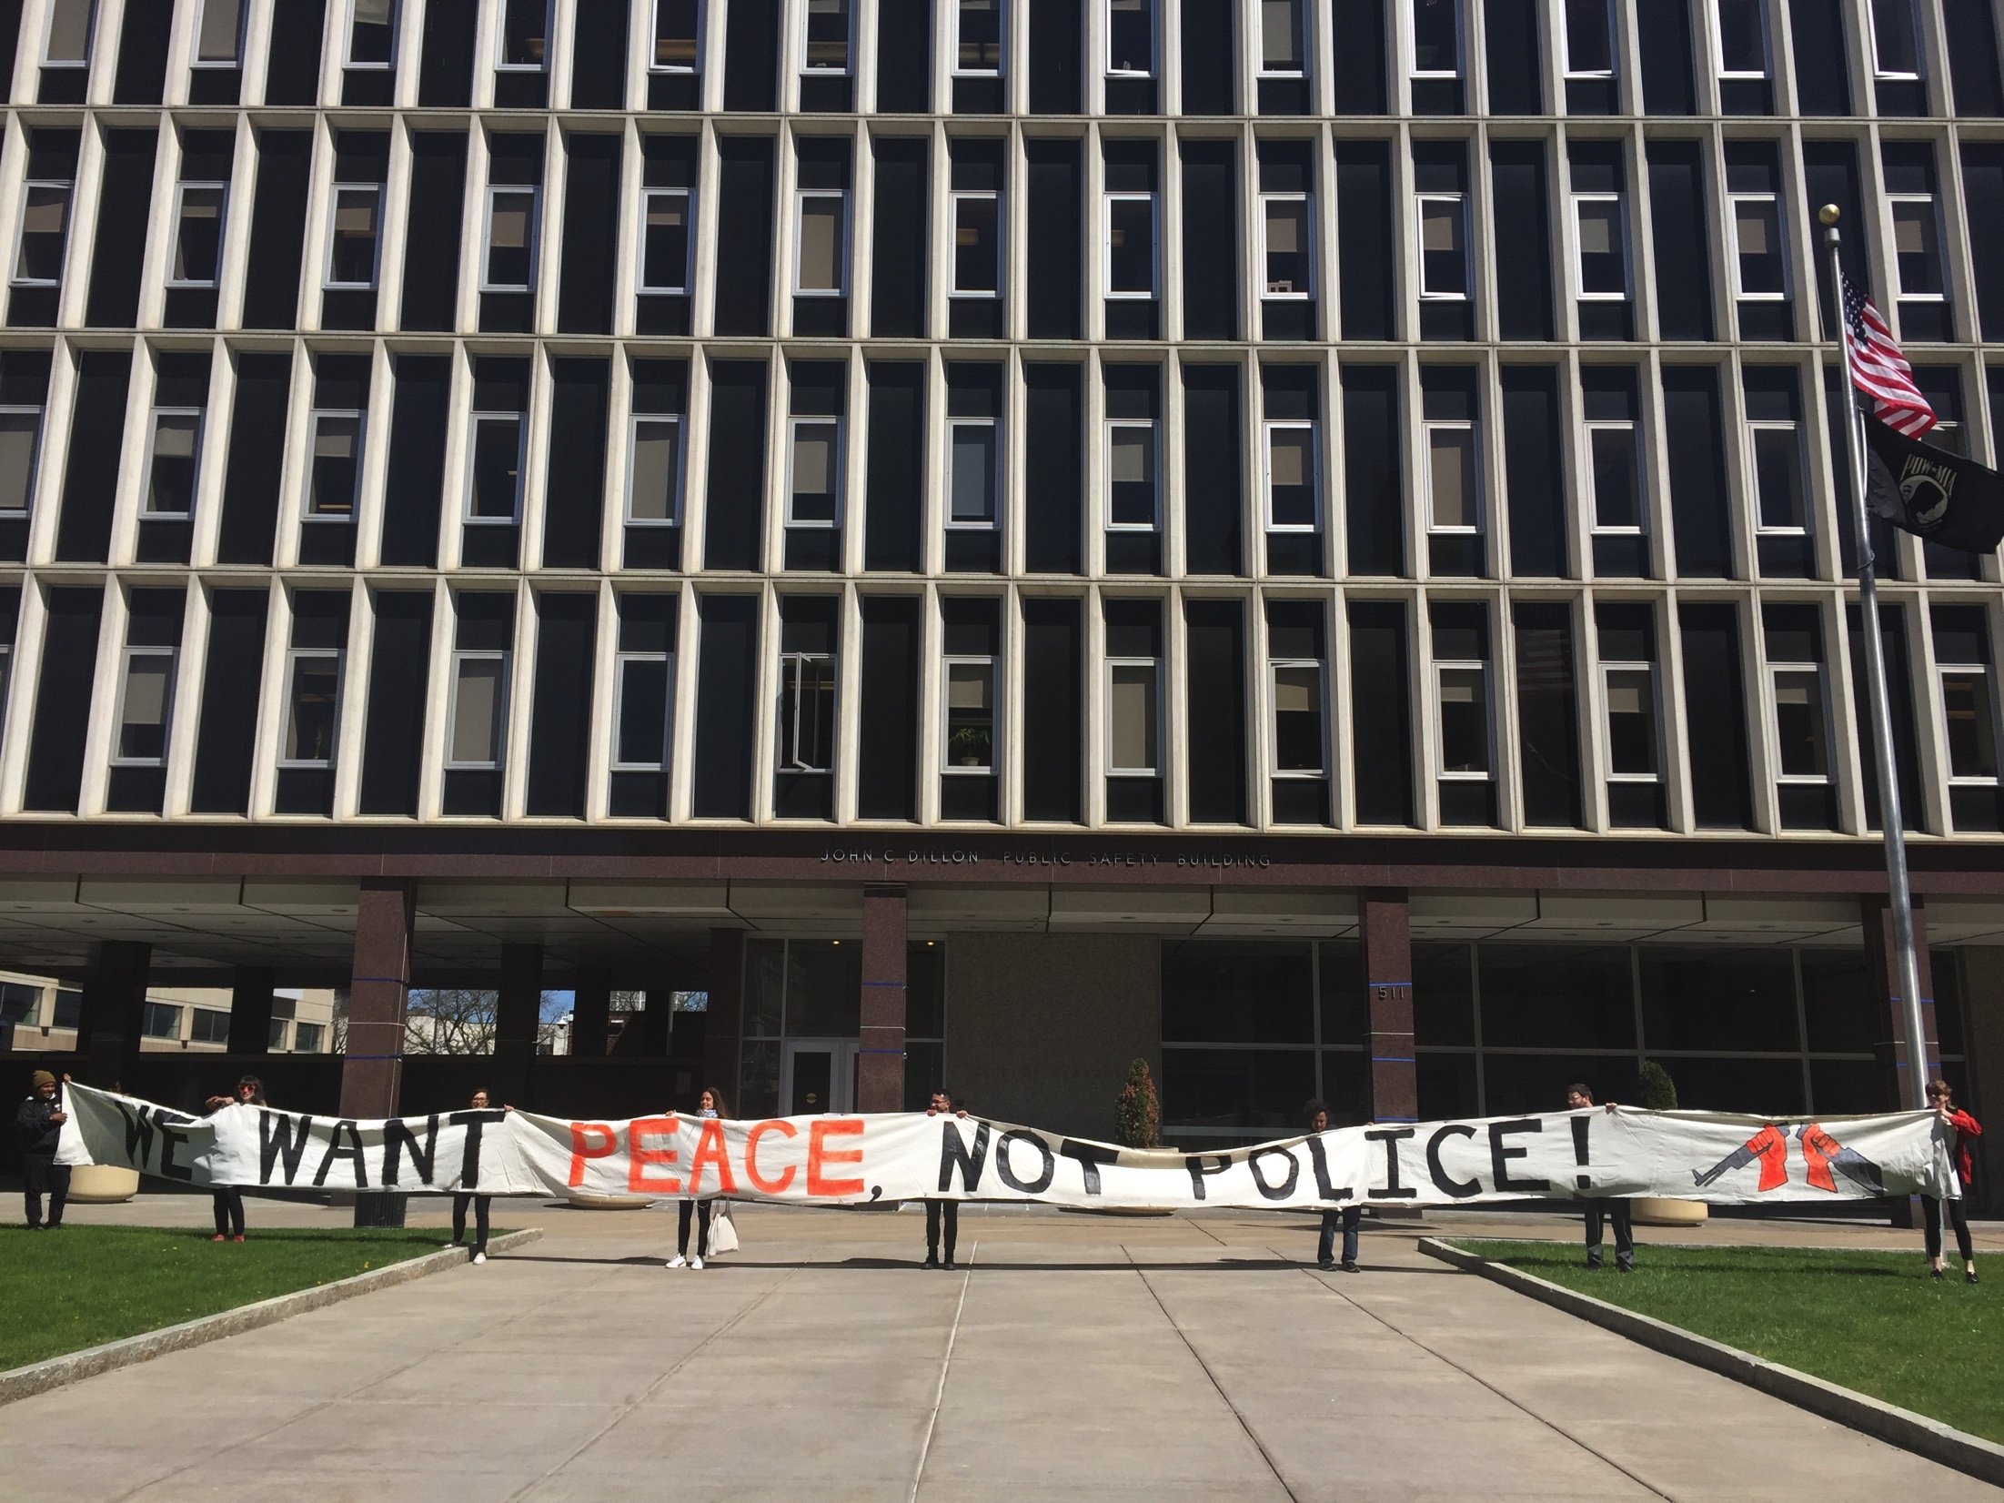
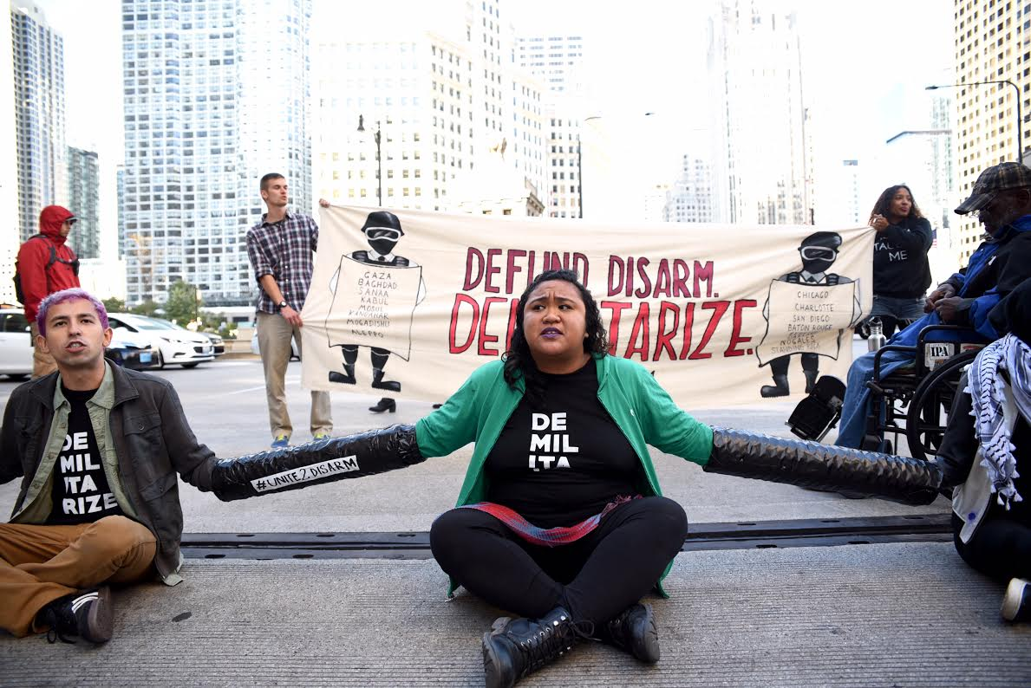
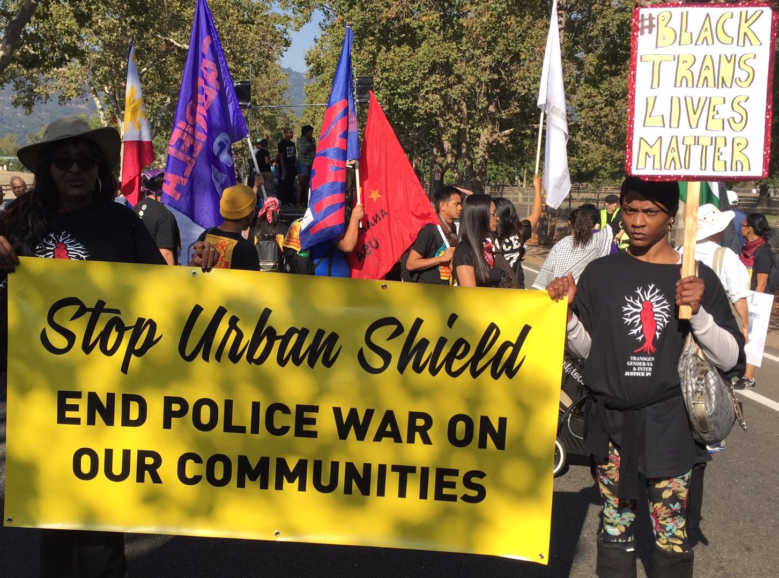
RESIST POLICE MILITARIZATION noSWATzone
WAR RESISTERS LEAGUE
TARA TABASSI

Slide 2
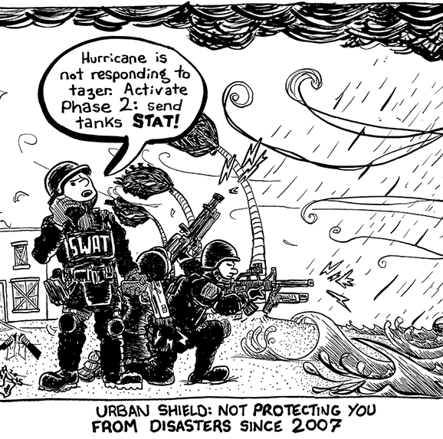
POLICE MILITARIZATION?
Police + military intersecting with weapons, equipment, funding + tactics, militarized mentalities + cultures
History of Policing
War on Drugs + Reagan
War on Terror + Patriot Act

Slide 3
S.W.A.T.?
S.W.A.T. = Special Weapons And Tactics
ACLU’s study of SWAT raids in 20 US cities
79% to search an individual’s home
42% Black people
12% Latinx people
NYT’s study of SWAT raids
PDs of 100+ have SWAT teams
½ of 81 SWAT killings = POC

Slide 4
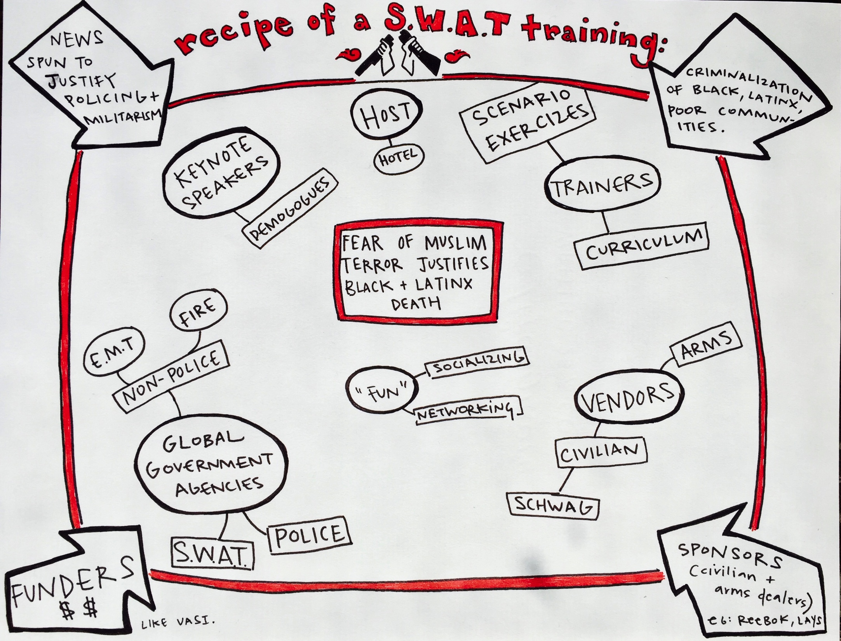
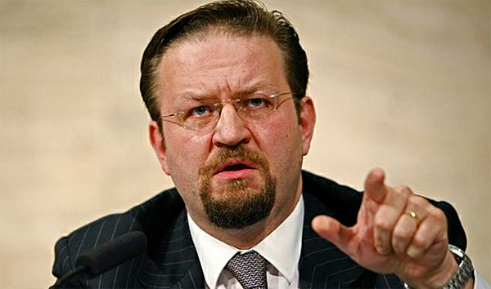

Slide 5
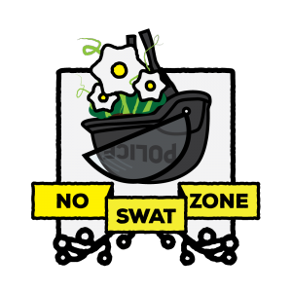
RESISTING SWAT TRAININGS
FIND A SWAT TRAINING + RESEARCH HOOK
BUILD CROSS-COMMUNITY COALITION
DEVELOP MESSAGING
MAKE PUBLIC OPPOSITION
POLITICAL EDUCATION (EVENTS + MATERIALS)
BUILD STRATEGY + RESEARCH
COORDINATE NATIONALLY + GLOBALLY
MEDIA + PETITIONS
EXPAND COALITION
RESTRATEGIZE! JOIN NOSWATZONE!
TAKE ACTION (CREATIVITY, ART + THEATRE)

Slide 6
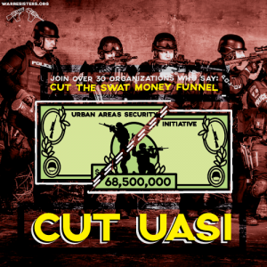
NATIONAL COORDINATION
2016: 35 community + national groups call on House Appropriations Committee to cut UASI budget: Let’s do it again!
Need:
- Coordinate across local coalitions
- Share national targets (like UASI)
- Find national champion

Slide 7
JOIN noSWATzone!
Find a SWAT training in your town/city. Hit up WRL for research + strategy support.
Join noSWATzone: help us research + strategize!
Make #SWATstories: Lift up experience of those being raided. Expose SWAT raids.
Hit me up! tara@warresisters.org

